Slide 1
Developing Your Course Training

Slide 2
Can you tell me who my rep is please?
Luke Burton, University of Nottingham Students’ Union

Slide 3
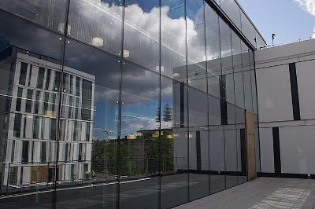
Developing Class Rep Training in Schools
David Arnold and Sophie McCallum
Edinburgh University Students’ Association

Slide 4
University of Edinburgh
There are over 30,000 students
Over 1,200 are Class Reps
Roughly 10% of these Class Reps receive training

Slide 5
Class Rep Training
Before 2011 EUSA’s Class Reps were trained by Associate Trainers
The training was well received, but generic
Became part of the pilot for Institutional Associate Trainers
Now develop our own training with an increased pool of trainers

Slide 6
Institutional Associate Trainers
Worked with support from sparqs to develop a program of training
Hired students from within the University of Edinburgh to deliver this training
Greater flexibility, increase in number of sessions, increase in number of Class Reps trained

Slide 7
Feedback
Class Reps responded well to being trained by their peers
The IAT’s enjoyed the flexibility and control they had over training
We were able to make changes quickly e.g. how we structured the session

Slide 8
School Specific Training
Of the negative comments, lack of specific detail was the most common
Over 20 different Schools organise their student feedback structures separately
School of Informatics one of the most different

Slide 9
Informatics Training
Meetings with both School Reps
Facilitating conversation with the trainer and the School Reps
Supporting School Reps to make changes to the booklet and trainer notes
Attended by staff support and School Rep
Specific feedback form

Slide 10
Ongoing Development
Informatics training very successful
Identified other Schools with unique set ups
Edinburgh College of Art
Law - working with their School Rep and the Law School Council
School Rep induction information

Slide 11
Any questions?

Slide 12
Thank You
For more information please do get in touch!
Sophie McCallum: sophie.mccallum@eusa.ed.ac.uk
Dave Arnold: david.arnold@eusa.ed.ac.uk

Slide 13
Reps, evidence based change and enhancement

Slide 14


Taking representation to the next
level
Notes:
These are some of the slides from the training that is delivered to returning or very involved Reps.

Slide 15

The feedback chain
You find out what the issues are
You tell the Uni what the issues are
You wait for the Uni to take action on the issues
Uni tell you what they have done to resolve your issues
You give students the feedback
single ownership
Notes:
Developing partnership with all stakeholders involved in representation is the key message that underpins this training. This culture change from a reporting structure to the partnership model has been driven forward by the introduction of the QAA Quality Code chapter B5: Student Engagement (live from Sep 2013).
Representation systems by their nature tend to adopt a single ownership approach, particularly within its infrastructure. In the past we have encouraged students to report issues up the chain, opposed to work proactively with staff on the ground to resolve them collaboratively.

Slide 16
University
Management
University
Students
Lot
Little
Tiny
Notes:
This means issues from students (by far the largest stakeholders) trickle up to the handful of people who have enough power to do something about it. Ironically, these people are the furthest point away from students on the ground and often make decisions based on second or third hand information.

Slide 17

Building a strong argument
Notes:
At this point of the training most students recognise that there is a need to change they way representation is structured and once we have planted the idea of working in partnership, we teach them the art of triangulation.
What are students on your course saying? (First hand/primary research)
What are students elsewhere are saying? (Surveys)
What are the University saying/doing? (The Source)

Slide 18
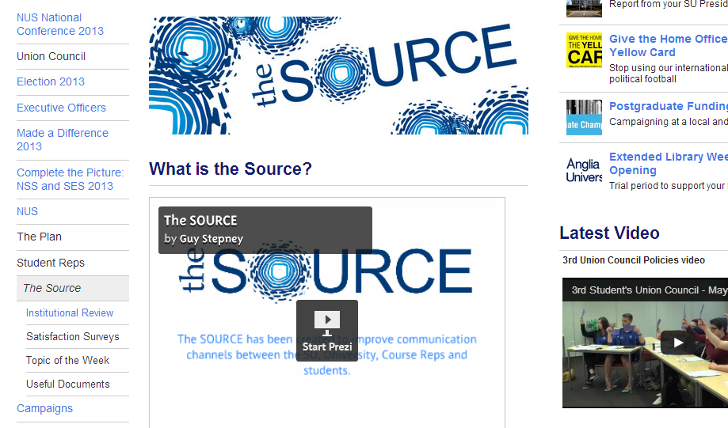
Notes:
The Source Prezi: the image above is hyperlinked.
The Source is a matrix of information from committees, the SU and students that is available on Google Docs via our website. This means it can be viewed by multiple parties and can be edited in real time. As it is accessible through our website, all of our stakeholders can see what we are monitoring and what action is being taken to improve their experience.

Slide 19
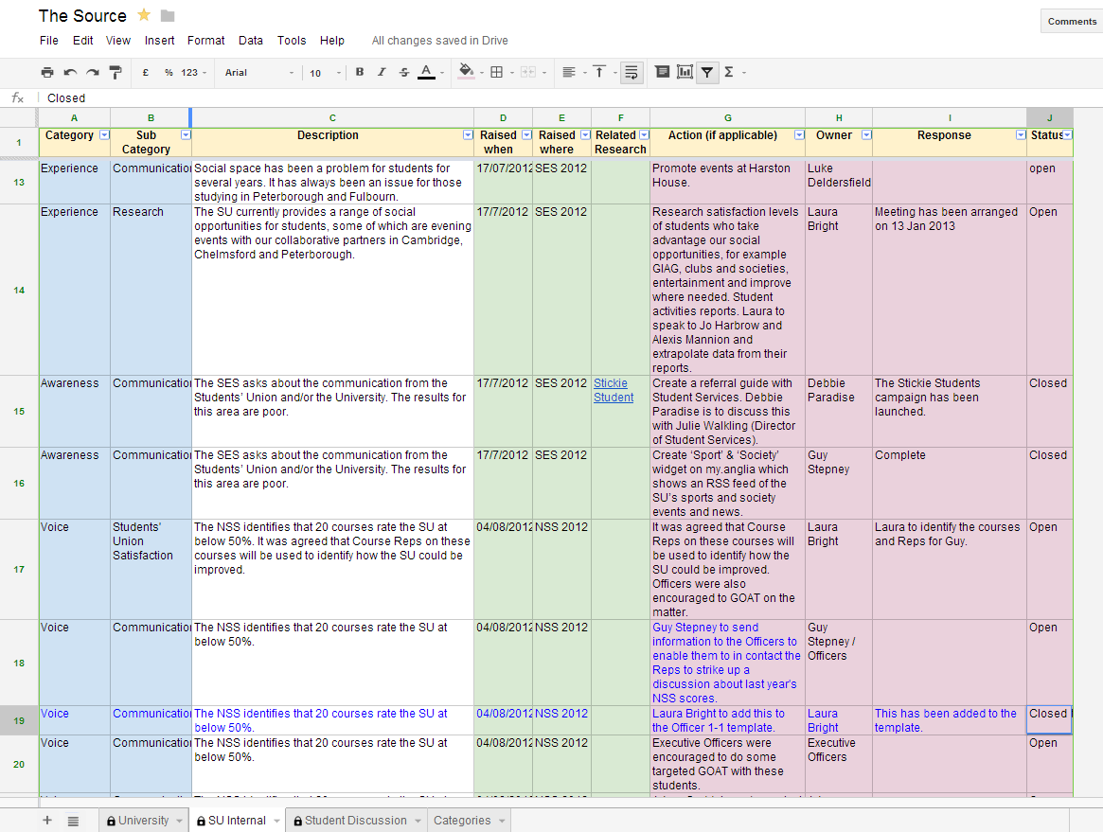
Notes:
The Source has the capacity to be filtered by category, which means stakeholders can easily access information on a topic or follow up on an action instead of trawling through lots of irrelevant data.

Slide 20




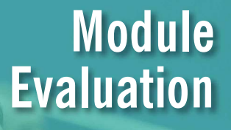






Student surveys and other information
Notes:
They also have access to useful documents and survey analysis via the website.
Our jobs as Course Rep and Quality Engagement Co-ordinators is to support students to construct their arguments/topics of discussion and help academic staff develop relationship with Reps. We do this on a one to one basis or with their course groups. We also capitalise on this data source by writing weekly emails to SU staff and Reps that snapshots the important information of the week and highlights the trending themes. This allows those who are not directly involved in the process have an oversight.

Slide 21
University
Management
University
Students
Lot
Little
Tiny
Notes:
As a result of this culture change, students are beginning to conduct their own research projects on a institutional level, which are financially supported by the University: what makes a good timetable project; creating identity in the Cambridge School of Art; placements booklets written by students for students.

Slide 22
Break

Slide 23
Student Partnership Agreements
Mike Williamson
Development Advisor

Slide 24
Background
Scottish Government put out a paper called Putting Learners at the Centre.
This paper mentioned the creation of Student Partnership Agreements, but didn’t really say what they are.
Since then, sparqs agreed to take on this work together with interested people from universities and colleges.

Slide 25
Charters
A list of consumer rights and responsibilities. For example:
HEFCE have been promoting this model in England.
Staff will:
Provide high quality learning opportunities
Return feedback within 3 weeks
Treat students with respect and dignity
Students will:
Turn up to class and pay attention
Complete assignments on time and thoroughly
Seek help when they need it
Take part in extracurricular activity

Slide 26

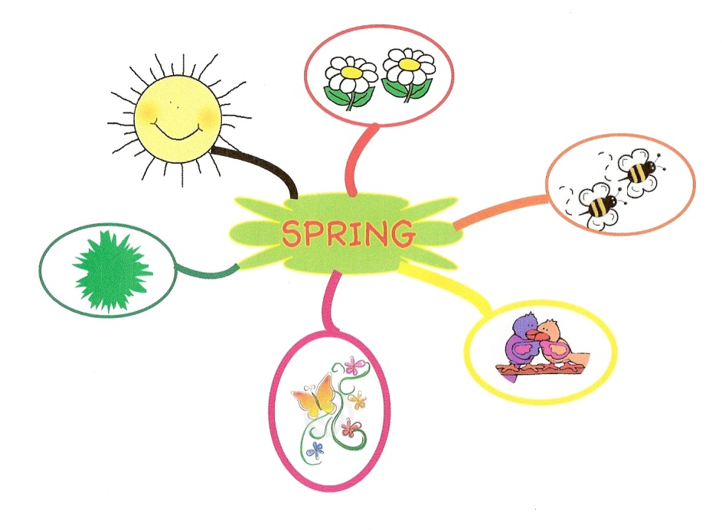
Scottish Context:
Quality Enhancement
Quality Assurance
Quality Enhancement

Slide 27
Scottish Context:
Student Engagement
Earliest Scottish universities were initially run democratically – Rectors were elected by students to run the university in the interests of students and the public.
The ‘Democratic Intellect’.
Students still at the centre of decisionmaking at universities in Scotland – especially in Learning and Teaching.

Slide 28
Challenges in developing SPA’s
Indicator 1: define and promote the range of opportunities for students to engage in quality.
Ensuring that the model is a tool for Quality Enhancement, not Quality Assurance.
Indicator 7: monitoring and reviewing the effectiveness of student engagement at least annually.
Avoiding a consumerist model.

Slide 29
Partnership Agreements
2 sections:
First section describes the different ways students and the university interact – to show students how they can work with staff to change things if they want to.
Second section shows what the Students Association and the University are going to work on together over the next year.

Slide 30
What does this have to do with class reps?
2 things:
During the process of putting together an SPA, there should be a consultation process to make sure students are feeding into the final agreement. Class reps are in a good position to take part in this consultation, but also to include other students in that process.

Slide 31
What does this have to do with class reps?
The guidance report also recommends that when it comes to implementing the Student Partnership Agreement, each department or school discusses the agreement to place the activity within their own context, and decide what specific actions they will take.
Class reps are ideally placed to take part in these discussions, and to help implement the proposals at a departmental and institution-wide level.

Slide 32
Enhancing Your Rep Activities
Iain Delworth, Development Advisor

Slide 33
Three documents
Mapping Rep Activities Session Plan: helps you define what a course rep does and gather information on the strengths and weaknesses of the current.
A Self Assessment Tool: this tool breaks down the different policies and activities associated with course reps and provides a structure to identify areas for enhancement.
The Course Rep Cycle: provides a timeline for both the institution/association and the rep themselves.

